Slide 1
2019-2020 Paratransit Plan March 13 & 15
Information Sessions

Slide 2
Information Session
Overview
Reasons and timing
Changes to service area, span, fares
Changes to operational policies
Important dates (public hearing)
Summary
Notes:
Overview on Paratransit and the Plan
Reasons and timing for changes
Key changes for 2020 (service area, span, fares)
Key changes for 2019 (operational policies)
Important dates
Summary

Slide 3
Meeting Overview
2 Topics:
Share proposal for the new Paratransit service area
Proposed operational policy changes as part of the updated Paratransit Plan
Purpose of the Meeting
Inform you, prepare you, get input
Notes:
The purpose of these sessions is to give you information about the major changes due to Reimagine and also to prepare you for the proposed policy changes to the Paratransit Plan.
This not a public hearing. You can offer input and comments during this session but it is not part of the formal process for receiving comments. We will give you details about the public hearing and comment process during this session.
We have a lot of information to cover. Every few slides, we will pause to make sure everyone is in synch and provide opportunities to ask questions. If we haven’t addressed a topic you are interested in, please hold your question until the end of the session so we can cover the agenda topics first.

Slide 4
Paratransit Is . . .
Comparable transportation service required by the ADA
For people whose disabilities prevent them from using fixed route
Available on the same basis as that provided to people using fixed route systems
Complements the fixed route system
Curb-to-curb by default
Notes:
In crafting the Americans with Disabilities Act (ADA), Congress recognized that even when a fixed route transit system is fully accessible, there will be some individuals whose disabilities prevent them from using the system. Congress therefore created a “safety net” to ensure that these individuals have transportation available to them on the same basis as individuals using fixed route systems.
Paratransit means comparable transportation service required by the ADA for individuals with disabilities who are unable to use fixed route transportation systems.
You will hear the expression “complementary” paratransit in the ADA regulations. The term means that the paratransit service acts to complete the whole transportation system.

Slide 5
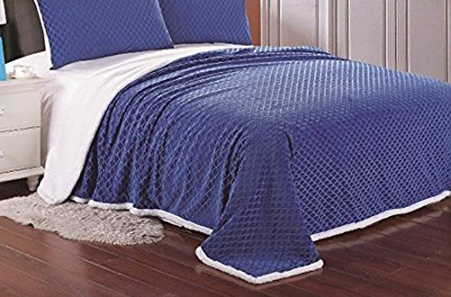
Paratransit and Fixed Route
Fixed route is like a bed
Paratransit is like a blanket
Notes:
Imagine a bed – it has a frame and a mattress and maybe a head-board or footboard. It has structure to support a person.
Fixed route is like that bed; it has a set structure that creates the foundation of the system to support people’s transportation needs.
Paratransit is like a blanket or comforter that spreads out over the top of the bed. Paratransit service sort of lays over the top of the fixed route structure.

Slide 6
Paratransit Is Not . . .
Not free
Not available just because someone uses a mobility device or has a disability
Not a non-emergency medical transportation service
Not a substitute for assistance provided by a Personal Attendant
Not identical to fixed route
Not door-to-door by default
Never door-through-door
Notes:
Paratransit is public transportation. It is not covered by medical insurance benefits. Just like fixed route, it costs a fare to ride.. The DOT ADA regulations allow agencies to charge up to twice the fare charged for fixed route service for the basic complementary paratransit service, and can determine any amount for any supplemental paratransit service.
People must apply for eligibility. Eligibility is not solely based on a person’s use of a mobility device or specific diagnosis. It is based on whether or not their disability prevents them from using the accessible fixed route buses, routes, and stop locations for all or some of their trips.
Customers can take trips for whatever purpose they need – not just for trips to medical appointments. However, RTS Access may not be the best option for people traveling in stretchers.
RTS Access Bus Operators cannot provide the same assistance with life functions as a Personal Attendant. The Bus Operators are limited to actions such as offering their arm to assist someone with balance as they walk, guiding or pushing a wheelchair along a clear paved path, and ringing an external doorbell or opening/closing an external door, and carrying a few small items.
Paratransit is not identical to fixed route because people need to call and reserve their rides. They also are accountable for using those reserved trips. Paratransit buses will operate within a set distance around a fixed route; so the buses can come to a curb in safe location near a person’s home or a specific facility.
RTS Access provides door to door as a reasonable modification (when requested by the customer when they reserve the trip, at the time of the trip, or when they apply or recertify for eligibility)
Not door-through-door (RTS Access Bus Operators cannot assist a person beyond the entrance – cannot go through the door into the dwelling or facility.

Slide 7
What is the Paratransit Plan?
Compares fixed route and paratransit service
Contains operational policies and procedures
Describes how we meet service criteria
Comparable Service Criteria
Service Area Response Time Fares Hours & Days of Service | (No) Restrictions on Trip Purpose (No) Capacity Constraints Process for Eligibility
Notes:
The Paratransit Plan is a formal, written comparison of fixed route and paratransit service.
The plan also is a comprehensive collection of operational policies and procedures for RTS Access and paratransit eligible customers.
The plan uses specific service criteria, set forth by the U.S. Department of Transportation ADA regulations, to identify how RTS Access service is comparable to RTS fixed route service.

Slide 8
Everyone Clear So Far? What Questions Do You Have?

Slide 9
Reasons for Change
Reimagine RTS (new fixed route structure)
New system changes the routes, service area and service span
Comparable paratransit runs in the same geographic areas and during the same hours as fixed routes
New Director of Paratransit
Comply with the laws
Improve efficiency and consistency
Include 2017 feedback
Make our policies “do-able”
Notes:
Reimagine RTS
The new fixed route system changes the routes, the service area, and the hours of service (“service span”)
Paratransit serves people with disabilities who cannot use fixed route service for some or all of their trips. Key criteria and characteristics of paratransit are based on the fixed route structure. So as the fixed route geographic area and service span changes, so too will the geographic area and service span change to become a comparable version of the fixed route.
New Director of Paratransit – Jamie Mott
I took over as the Director in June of 2018. I previously was the Regional Manager for RTS service in Genesee and Orleans counties.
Our staff and fleet are small but play an important role in the community. It is vital for us to be as efficient as possible so we can focus energy and attention on providing paratransit service that is consistent for customers and compliant with FTA and ADA laws. I’ve used data about our ridership and trips, the expertise of my staff, and the input the community gave us back in November 2017 to make adjustments to our policies and procedures so that we can best achieve efficiency, compliance, and consistency. Making our policies realistic, feasible, and available means that we can all work together better because everyone can realistically understand and carry out the expectations.

Slide 10
Timing for Change
June of 2019
Board review of Paratransit Plan
Operational policies may begin to go into effect after Board approval and when feasible
Summer of 2020
Redesigned RTS system goes into effect
Changes to RTS Access service area, service span, fares, and reservations also go into effect
All new or revised operational policies go into effect
Notes:
In June 2019, the Paratransit Plan will go to the Board for review and approval. That is why we are holding information sessions with you now and will hold a Public Hearing in April. This provides you with the ability to comment on the Plan.
If the Board approves the plan, we will begin to enact some of the operational policies where feasible.
When Reimagine RTS goes into effect in the Summer of 2020, the changes to the RTS Access service area, service span, and fares will also go into effect.

Slide 11
Everyone Clear So Far? What Questions Do You Have?

Slide 12
Service Changes in 2020
Key Changes for Summer 2020
Service area
Service span
Fares
Notes:
The service area in 2020 will change to complement (mirror) the redesigned fixed routes. We will implement 3 levels of supplemental service to expand the geographic coverage for paratransit into areas in the suburbs. We will discuss this as part of the next set of slides in this information session.
The service span refers to the hours of service. In 2020, RTS Access service will run during the same hours as fixed route during weekdays and weekends. Again, we will discuss this in detail in a few minutes.
In 2020, we will begin a simplified fare structure for paratransit services that is also compliant with ADA regulations.

Slide 13
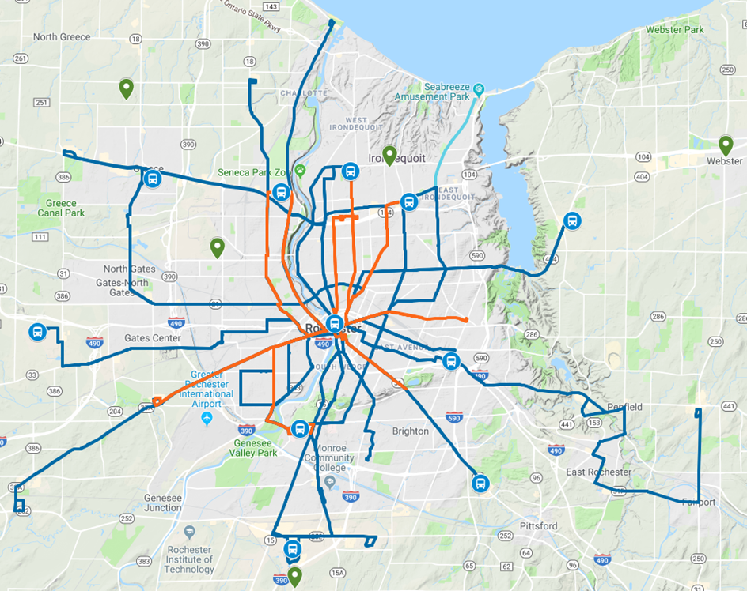
2020 Service Area
Redesigned Fixed Route is the Baseline for the new Service Area
Notes:
Here we are quickly showing the visual image of the redesigned fixed route system. It has routes that run north to south and east to west and these are shown as defined lines. Many of the lines go to the Transit Center but a few do not.
There is a narrative describing the new fixed route system in Exhibit 1 of the Paratransit Plan.

Slide 14
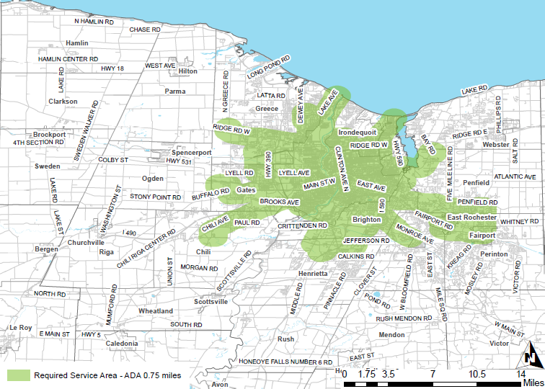
Paratransit Weekday Service Area
2020 Service Area
Notes:
The paratransit service area lays over the top of the fixed route structure.
Returning to the bed and blanket idea, there are several shapes.
The green blob shape is the required complementary paratransit service area. This area surrounds all the fixed routes running during the week. The complementary paratransit area is the geographic space where RGRTA is required by law to provide paratransit service. It is ¾ of mile around each side of each fixed route. The green Required Area is like the blanket on the top of a bed. It provides basic coverage.
Surrounding the Required area are 3 levels of supplemental service: Level 1 is blue, Level 2 is orange, and Level 3 is gray.
Supplemental service is provided at RGRTA’s discretion. It is not required by DOT ADA law and does not need to comply with the same service criteria.
The supplemental service in Level 1 extends ¾ miles beyond the Required Area, to create coverage 1 ½ miles around each fixed route in the system. RTS Access provides subscription service in this area. So imagine a few people standing around the bed and holding up the edges of the blanket all around the bed ; now the blanket extends beyond the edge of the mattress and frame.
RTS Access will make its best effort to deliver the same service criteria for Level 1 as it does for the Required Area, so this will allow customers to negotiate pickup times, reserve rides in advance, and guarantees a ride with 1 day advance reservation. RTS Access will provide subscription service in Level 1.
Level 2 are the orange shapes sitting beyond the green and blue areas. The supplemental service in Level 2 extends to the Community Mobility Zone areas that are not already covered by the Required Area or Level 1. The picture shows that the green and blue sort of lay over the top of large sections of the Community Mobility Zones. So now imagine the people who are holding the edges of the blanket start to stretch the blanket it out a little more. RTS Access will make its best effort to deliver the same service criteria for Level 2 as it does for the Required Area.. RTS Access will provide subscription service in Level 2.
Level 3 is the gray area farthest out in all directions from the Required Area. The supplemental service in Level 3 extends to form a 1.25 mile border around the Required Area and Level 2. The supplemental service in Level 3 will be on a space-available basis only . Reservations can be made up to 1 day in advance, but trips are not guaranteed. So, this is like the people holding the blanket stretch it out as far as it will go on all sides while still covering the bed.

Slide 15
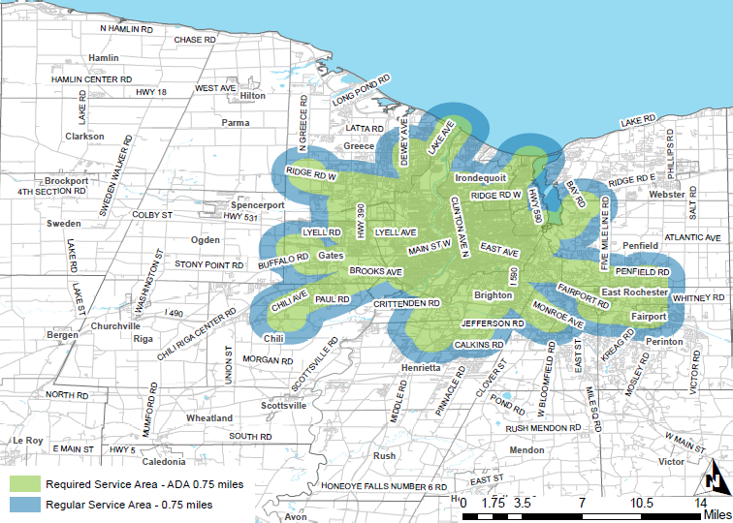
Paratransit Weekday Service Area
2020 Service Area
Notes:
The paratransit service area lays over the top of the fixed route structure.
Returning to the bed and blanket idea, there are several shapes.
The green blob shape is the required complementary paratransit service area. This area surrounds all the fixed routes running during the week. The complementary paratransit area is the geographic space where RGRTA is required by law to provide paratransit service. It is ¾ of mile around each side of each fixed route. The green Required Area is like the blanket on the top of a bed. It provides basic coverage.
Surrounding the Required area are 3 levels of supplemental service: Level 1 is blue, Level 2 is orange, and Level 3 is gray.
Supplemental service is provided at RGRTA’s discretion. It is not required by DOT ADA law and does not need to comply with the same service criteria.
The supplemental service in Level 1 extends ¾ miles beyond the Required Area, to create coverage 1 ½ miles around each fixed route in the system. RTS Access provides subscription service in this area. So imagine a few people standing around the bed and holding up the edges of the blanket all around the bed ; now the blanket extends beyond the edge of the mattress and frame.
RTS Access will make its best effort to deliver the same service criteria for Level 1 as it does for the Required Area, so this will allow customers to negotiate pickup times, reserve rides in advance, and guarantees a ride with 1 day advance reservation. RTS Access will provide subscription service in Level 1.
Level 2 are the orange shapes sitting beyond the green and blue areas. The supplemental service in Level 2 extends to the Community Mobility Zone areas that are not already covered by the Required Area or Level 1. The picture shows that the green and blue sort of lay over the top of large sections of the Community Mobility Zones. So now imagine the people who are holding the edges of the blanket start to stretch the blanket it out a little more. RTS Access will make its best effort to deliver the same service criteria for Level 2 as it does for the Required Area.. RTS Access will provide subscription service in Level 2.
Level 3 is the gray area farthest out in all directions from the Required Area. The supplemental service in Level 3 extends to form a 1.25 mile border around the Required Area and Level 2. The supplemental service in Level 3 will be on a space-available basis only . Reservations can be made up to 1 day in advance, but trips are not guaranteed. So, this is like the people holding the blanket stretch it out as far as it will go on all sides while still covering the bed.

Slide 16
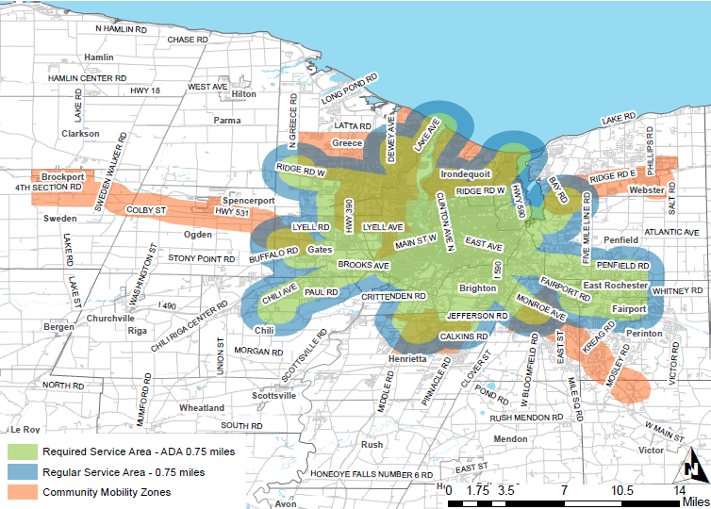
Paratransit Weekday Service Area
2020 Service Area
Notes:
The paratransit service area lays over the top of the fixed route structure.
Returning to the bed and blanket idea, there are several shapes.
The green blob shape is the required complementary paratransit service area. This area surrounds all the fixed routes running during the week. The complementary paratransit area is the geographic space where RGRTA is required by law to provide paratransit service. It is ¾ of mile around each side of each fixed route. The green Required Area is like the blanket on the top of a bed. It provides basic coverage.
Surrounding the Required area are 3 levels of supplemental service: Level 1 is blue, Level 2 is orange, and Level 3 is gray.
Supplemental service is provided at RGRTA’s discretion. It is not required by DOT ADA law and does not need to comply with the same service criteria.
The supplemental service in Level 1 extends ¾ miles beyond the Required Area, to create coverage 1 ½ miles around each fixed route in the system. RTS Access provides subscription service in this area. So imagine a few people standing around the bed and holding up the edges of the blanket all around the bed ; now the blanket extends beyond the edge of the mattress and frame.
RTS Access will make its best effort to deliver the same service criteria for Level 1 as it does for the Required Area, so this will allow customers to negotiate pickup times, reserve rides in advance, and guarantees a ride with 1 day advance reservation. RTS Access will provide subscription service in Level 1.
Level 2 are the orange shapes sitting beyond the green and blue areas. The supplemental service in Level 2 extends to the Community Mobility Zone areas that are not already covered by the Required Area or Level 1. The picture shows that the green and blue sort of lay over the top of large sections of the Community Mobility Zones. So now imagine the people who are holding the edges of the blanket start to stretch the blanket it out a little more. RTS Access will make its best effort to deliver the same service criteria for Level 2 as it does for the Required Area.. RTS Access will provide subscription service in Level 2.
Level 3 is the gray area farthest out in all directions from the Required Area. The supplemental service in Level 3 extends to form a 1.25 mile border around the Required Area and Level 2. The supplemental service in Level 3 will be on a space-available basis only . Reservations can be made up to 1 day in advance, but trips are not guaranteed. So, this is like the people holding the blanket stretch it out as far as it will go on all sides while still covering the bed.

Slide 17
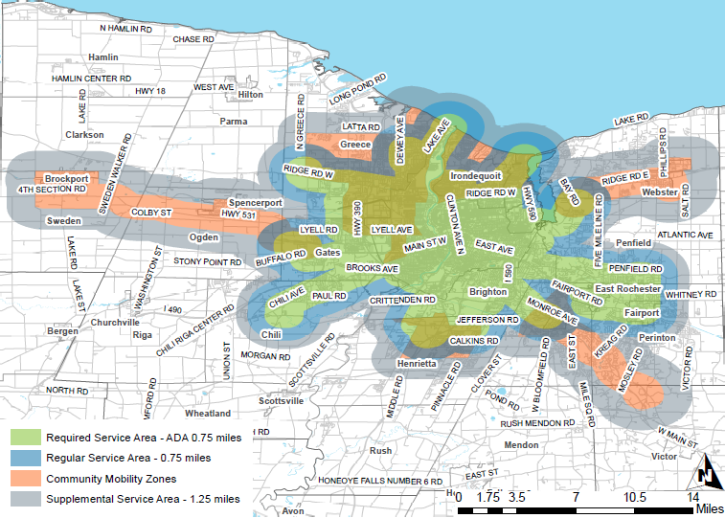
Paratransit Weekday Service Area
2020 Service Area
Notes:
The paratransit service area lays over the top of the fixed route structure.
Returning to the bed and blanket idea, there are several shapes.
The green blob shape is the required complementary paratransit service area. This area surrounds all the fixed routes running during the week. The complementary paratransit area is the geographic space where RGRTA is required by law to provide paratransit service. It is ¾ of mile around each side of each fixed route. The green Required Area is like the blanket on the top of a bed. It provides basic coverage.
Surrounding the Required area are 3 levels of supplemental service: Level 1 is blue, Level 2 is orange, and Level 3 is gray.
Supplemental service is provided at RGRTA’s discretion. It is not required by DOT ADA law and does not need to comply with the same service criteria.
The supplemental service in Level 1 extends ¾ miles beyond the Required Area, to create coverage 1 ½ miles around each fixed route in the system. RTS Access provides subscription service in this area. So imagine a few people standing around the bed and holding up the edges of the blanket all around the bed ; now the blanket extends beyond the edge of the mattress and frame.
RTS Access will make its best effort to deliver the same service criteria for Level 1 as it does for the Required Area, so this will allow customers to negotiate pickup times, reserve rides in advance, and guarantees a ride with 1 day advance reservation. RTS Access will provide subscription service in Level 1.
Level 2 are the orange shapes sitting beyond the green and blue areas. The supplemental service in Level 2 extends to the Community Mobility Zone areas that are not already covered by the Required Area or Level 1. The picture shows that the green and blue sort of lay over the top of large sections of the Community Mobility Zones. So now imagine the people who are holding the edges of the blanket start to stretch the blanket it out a little more. RTS Access will make its best effort to deliver the same service criteria for Level 2 as it does for the Required Area.. RTS Access will provide subscription service in Level 2.
Level 3 is the gray area farthest out in all directions from the Required Area. The supplemental service in Level 3 extends to form a 1.25 mile border around the Required Area and Level 2. The supplemental service in Level 3 will be on a space-available basis only . Reservations can be made up to 1 day in advance, but trips are not guaranteed. So, this is like the people holding the blanket stretch it out as far as it will go on all sides while still covering the bed.

Slide 18
Paratransit Weekend Service Area
2020 Service Area
Notes:
During the weekends, the paratransit service area is the Required Area (green) which provides the basic complementary coverage for the fixed route system – ¾ miles around all the fixed routes.
Then, there is Level 1 supplemental service (blue). This again extends and additional ¾ miles beyond the Required Area.
On weekends, the paratransit area does not provide supplemental service to Level 2 or Level 3.
So, here there is a blanket on the bed and people are just holding up the edges of the blanket right around the bed.

Slide 19
Before We Talk About Service Hours and fares, What Questions Do You Have About the Service Area?

Slide 20
2020 Service Span Paratransit
Weekdays
Required Area: Monday - Friday, 5:00 AM to midnight
Level 1: Monday - Friday, 5:00 AM to midnight
Level 2: Monday - Friday, 5:00 AM to 7:00 PM (no holidays)
Level 3: Monday - Friday, 5:00 AM to 7:00 PM (no holidays)
Weekends
Required Area: 6:00 AM to midnight
Level 1: 6:00 AM to midnight

Slide 21
2020 Fares for Paratransit
Required Area: $2.00 per trip (GREEN Area)
Level 1 Supplemental: $2.00 per trip (BLUE Area)
Level 2 Supplemental: $5.00 per trip (ORANGE Area)
Level 3 Supplemental: $8.00 per trip (GRAY Area)
Same-day Service: additional $6 per trip
No more Rider Rewards Program
No more $18 Value Pass
The $20 Value Pass = $22 in fares

Slide 22
Summary of Service Changes
Paratransit service area
Weekdays: covers all locations within ¾ of the fixed routes and supplemental service in 3 areas
Weekends: covers the Required Area and the supplemental service in Level 1
Service hours
Weekdays in the Required Area and Level 1: 5:00 AM to midnight
Weekdays in Level 2 and Level 3: 5:00 AM to 7:00 PM (no holidays)
Weekends in Required Area and Level 1: 6:00 AM to midnight
Fares
$2.00 per ride for Required Area and Level 1 (advance reservation)
$5.00 per ride for supplemental service in Level 2
$8.00 per ride or supplemental service in Level 3
$6 extra for same-day service

Slide 23
Operational Policy Changes for 2019-2020

Slide 24
Key Operational Policy Changes
Eligibility certification
Advance reservations
Service infractions and suspensions
Subscription service
Pickup window
Pickup periods for return trips (No Strand)
Remember: All policies are fully detailed the Paratransit Plan!
Notes:
In 2019, we will begin to roll out operational policies where feasible, but not until we have Board approval in June 2019.
Adjusting the number of days for advance reservations
Pickup window
Subscription Service
Service Infractions and Suspensions
Eligibility certification
Pickup Periods for Return Trips and No Strand Policy

Slide 25
Key Operational Policy Changes (Cont.)
Eligibility Certification
All-Trip Eligibility with a simple renewal process replaces the current Unconditional Eligibility
Conditional Eligibility now includes Seasonal Eligibility
Temporary Eligibility and Visitors – no change
Advance Reservations
5-day advance reservations (down from 7-day advance reservations)
Scheduling hours on weekends: 8am – 1pm
On-line scheduling coming soon!
Notes:
All-Trip
With All-Trip Certification, you are eligible to use A D A paratransit for all trips within the service area served by fixed route. The basis for an All-Trip determination is as follows. The condition preventing you from functionally using fixed route in any capacity is unlikely to improve and there is strong evidence that your inability to use fixed route will not change. Your certification will expire every three years and you will be required to renew it. We will have you fill out a simple form to make sure we have accurate information about you, such as your phone number, address, designees, and travel needs.
4.2. Conditional
With Conditional Certification, you can use A D A paratransit for some trips, but not others, depending on your disabilities, the availability of accessible fixed-route service, and the barriers to reaching it.
You can use paratransit under the conditions where your disability prevents you from using fixed route service. As a result of your application or recertification and functional assessment, we determined that you are able to use fixed route bus service under certain conditions and are eligible to use paratransit when you are not able to use fixed route buses. We will provide you with a description of the conditions under which you can use paratransit as well as the basis for our determination.

Slide 26
Key Operational Policy Changes (Cont.)
Service infractions and suspensions
Includes No-shows, Late Cancellations and Cancel at Door
Measured each month; everyone starts the 1st day of a new month at zero infractions!
Resets every year; everyone starts January at zero
Always excludes situations outside of your control but you must tell us!
Subscription service
Easier to apply; no more wait period unless capacity is met
Easier to change address – we will do it unless capacity is met
Introducing short term subscriptions!
Notes:
All-Trip
With All-Trip Certification, you are eligible to use A D A paratransit for all trips within the service area served by fixed route. The basis for an All-Trip determination is as follows. The condition preventing you from functionally using fixed route in any capacity is unlikely to improve and there is strong evidence that your inability to use fixed route will not change. Your certification will expire every three years and you will be required to renew it. We will have you fill out a simple form to make sure we have accurate information about you, such as your phone number, address, designees, and travel needs.
4.2. Conditional
With Conditional Certification, you can use A D A paratransit for some trips, but not others, depending on your disabilities, the availability of accessible fixed-route service, and the barriers to reaching it.
You can use paratransit under the conditions where your disability prevents you from using fixed route service. As a result of your application or recertification and functional assessment, we determined that you are able to use fixed route bus service under certain conditions and are eligible to use paratransit when you are not able to use fixed route buses. We will provide you with a description of the conditions under which you can use paratransit as well as the basis for our determination.

Slide 27
Key Operational Policy Changes (Cont.)
Pickup window
The window will change to 5 minutes before the pickup time and end 15 minutes after the pickup time
The “Pickup Period” remains at 20 minutes (the window of time scheduled for the bus to arrive for your pickup)
Pickup periods for return trips (No Strand)
The “Final Pickup Period” is the latest pickup period for a return trip
If you don’t show for your scheduled return trip pickup, you can ask us to schedule a return trip so you are not stranded
Only during regular service hours
Might need to wait longer than normal
Notes:
All-Trip
With All-Trip Certification, you are eligible to use A D A paratransit for all trips within the service area served by fixed route. The basis for an All-Trip determination is as follows. The condition preventing you from functionally using fixed route in any capacity is unlikely to improve and there is strong evidence that your inability to use fixed route will not change. Your certification will expire every three years and you will be required to renew it. We will have you fill out a simple form to make sure we have accurate information about you, such as your phone number, address, designees, and travel needs.
4.2. Conditional
With Conditional Certification, you can use A D A paratransit for some trips, but not others, depending on your disabilities, the availability of accessible fixed-route service, and the barriers to reaching it.
You can use paratransit under the conditions where your disability prevents you from using fixed route service. As a result of your application or recertification and functional assessment, we determined that you are able to use fixed route bus service under certain conditions and are eligible to use paratransit when you are not able to use fixed route buses. We will provide you with a description of the conditions under which you can use paratransit as well as the basis for our determination.

Slide 28
Everyone Clear So Far? What Questions Do You Have?

Slide 29
Other Details in the Plan
States explicitly what the Scheduler asks
Addresses the topics that customers voiced concerns with in 2017
Service animals
Children
PCAs
Early departures
Restroom requests

Slide 30
Important Dates
Review the Plan:
March 19: An accessible Word file that is compatible with Screen Readers will be posted online
Public Hearing on the Paratransit Plan:
April 2 at RTS
Written Comment Deadline:
April 16

Slide 31
Public Hearing
WHEN:
Tuesday, April 2, 2019, 5:00-6:30 p.m.
WHERE:
RTS Board Conference Room
1372 East Main Street
Rochester, NY 14609
WRITTEN COMMENT DEADLINE:
April 16 AT 5:00 p.m.
Rochester Genesee Regional Transportation Authority
Attn: General Counsel
1372 East Main Street, Rochester, NY 14609

Slide 32
Thank You
Questions?

